Slide 1
Week 8
Overcoming Objections

Slide 2
Professional Language and Handling Questions and Objections
Learn the language of Market America

Slide 3
Don’t be lazy with your words

Slide 4
Don’t say this
Instead say this
I JOINED Market America
I started my own business
I’m a member of Market America
I own a business
I do Market America
I work for myself
There’s a UBP meeting Tuesday night
There is a business presentation Tuesday night

Slide 5
Don’t say this
Instead say this
I hit 1200 and 1200 and got my first check
I earned my first commission
My sponsor’s name is Dan
My business partner’s name is Dan
I want you to meet the people in my upline
I want you to meet my business partners
I already have people below me
My business is already growing

Slide 6
Don’t say this
Instead say this
The person I am working with is a National Supervising Coordinator
The person I am working with has exceeded $10,000 in a month in commissions
When do you want to sign-up/get in?
When would you like to start/register your business?
Check out my SHOP.COM portal
Check out my SHOP.COM SITE

Slide 7
Overcoming Objections
Objections simply say No, Not Now, Not interested or
It can be a way to test us.

Slide 8
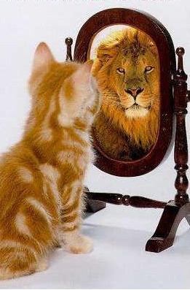
Posture! Posture! Posture!

Slide 9
TIPS
Reply with a Question to a Question
Don’t rush into defensive mode
If don’t know: Great Question. I will find out and
get back to you.
Leverage Senior Partner help

Slide 10
No
Is this a pyramid?
Pyramids are illegal
A pyramid pays for recruiting instead of being based on product sales
This is a legitimate business with a proven track record since 1992
A+ rating from the Better Business Bureau
Every corporation’s organizational structure resembles a pyramid

Slide 11
Is this Amway?
is this multi-level marketing?
No
What has been your experience with (Amway or multi-level marketing)?
We took the best of franchising and networking and eliminated the flaws

Slide 12
MA vs MLM
Market America
Multi-Level Marketing
Binomial System, Vertical Marketing
100% Infinity from the bottom up
BV=365 days, IBV=730 days
Buy products from Company
Paid Weekly
Need only 2 good partners
5000 Cap
2-3 yrs part-time
Product Brokerage Company
NMTSS (open- house)
MPCP never change in 20 yrs
Polynomial, Multiply: Horizontal
Depending % of which level
Majority 30 days ex: Amway
Buy products from uplines & uplines make retail profit
Paid Monthly
Can not stop recruiting
No Cap
Can never Stop
Limited Products ex. Mary Kay
Not Welcome to others
MLM companies change and copy (Unstable)

Slide 13
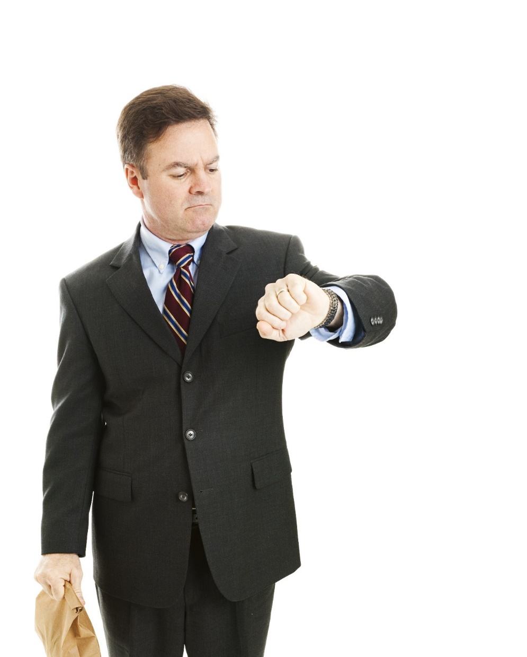
I just don’t have any time
Acknowledge the comment and follow with: “Today, no one seems to have time with _____”
Agree with the comment and follow with: “Can we get together for coffee? I could use your help and you may know the right people.”
“The additional income generated could help create more free time.”

Slide 14
I just don’t have the money
If you are interested and money is the only thing holding you back, let’s set up a product event and generate some sales.
We’ll do the work with you and run it by people you know. If we can find you the right people, then it’s already profitable.

Slide 15
I have to talk with my spouse
That’s a great idea, would it be possible for the three of us to get together?

Slide 16
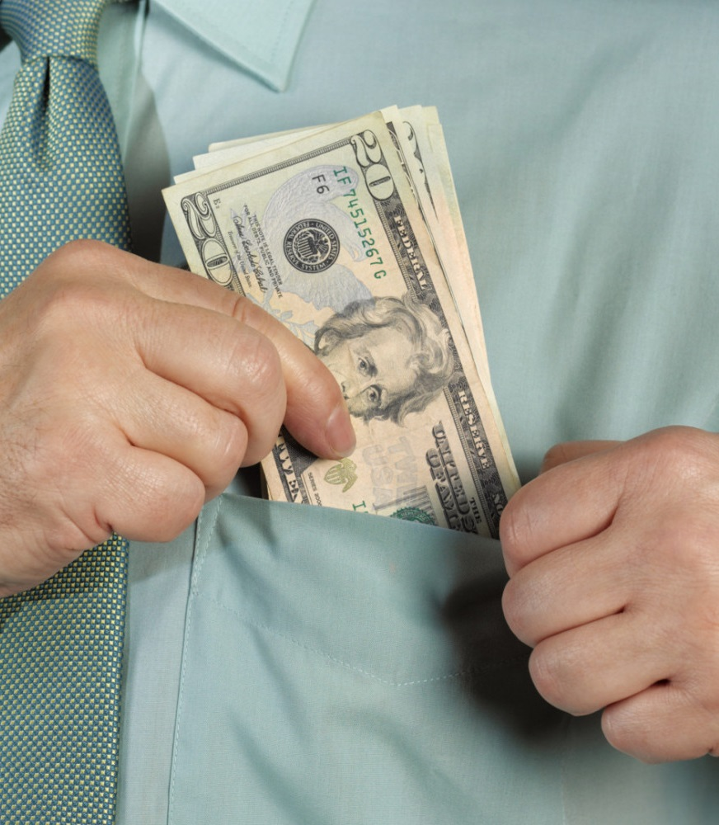
If you are NEW
I am just getting started
I already recouped my initial investment
I am already earning retail profits, and I am on my way to earning commissions
If you are NOT new
How much are you earning? Are you making any money yet?
Initially I was earning retail profits, now I am expanding my team and earning commissions

Slide 17
Let Me Think About It
Great, let’s get back together in a couple of days to answer any questions you come up with. Let’s schedule the appointment now.
Great, one of the best ways to evaluate our business is to attend one of our trainings. (sell them a ticket)
Great, while you are thinking about it why don’t you try one of our exclusive products.

Slide 18
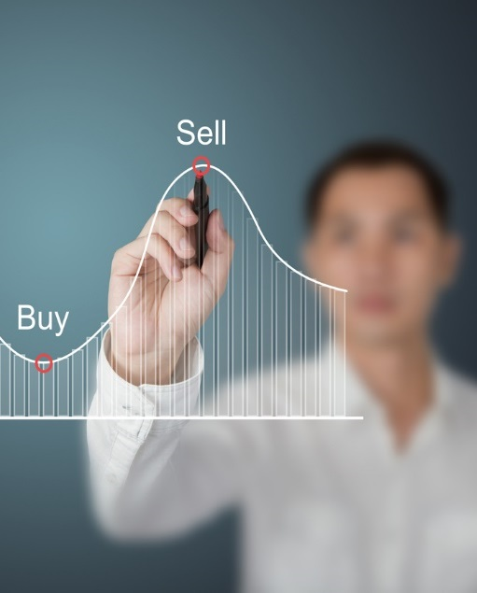
Do I Have To Sell Anything?
Yes. This is a business
People love our products and find it easy to talk about them
SHOP.COM pays people Cashback on purchases when they shop at their favorite online stores

Slide 19
I’m not interested
Before seeing the plan
I wasn’t sure if you would be. Could we get still get together because you may know the right people and I would appreciate your help.

Slide 20
I’m not interested
After seeing the plan
Timing may not be right for you now.
Would you mind if I stay in touch?
No problem, would you be interested in trying some products or referring some people that may be interested?

Slide 21
FINAL TIPS
Learn How To Show The Plan!
MAM
Don’t be Weird
No means LATER
Take Action!
Have fun!
Never Give Up!

